Slide 1
Games Engineering
Group R Game Pitch

Slide 2
The Game
The Game which for now is known as “Run n Gun” will be a top-down game featuring a sprite.
It will be a 2D top down shooter in which the player will have to destroy as many enemies as possible without being destroyed themselves in a set amount of time
The aim of the game is to create a high-score within the set amount of time

Slide 3
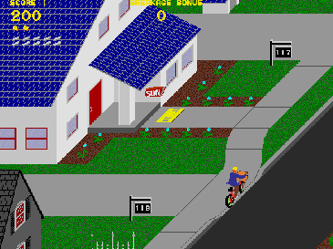
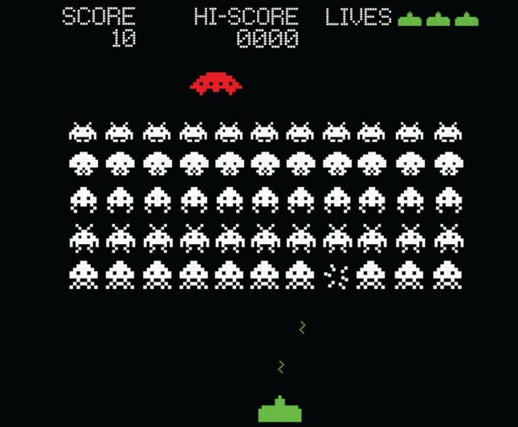
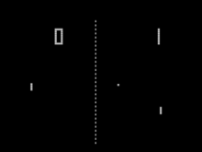
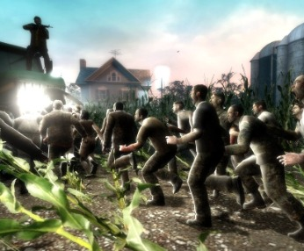
Inspiration
It will draw inspiration from the pong and space invaders examples in the course for parts of the core gameplay.
Top down shooters – The primary inspiration as that’s what the game will be
Left 4 Dead - Single player but the idea of being attacked by groups of enemies

Slide 4
Player Experience
The main part of the player experience is to achieve the highest score which will be compared to other high scores – similar to old arcade games
There will be a time limit for the game to add to a sense of danger that the player must achieve the said score within the amount of time

Slide 5
Core Gameplay
Player is in control of a sprite that can move on a 2D top down field
Player is able to shoot from the sprite
Player is attacked by Waves of “Bad sprites”
“Bad Sprites” can damage player
Player has to destroy as many bad sprites as possible in a time limit without getting destroyed themselves

Slide 6
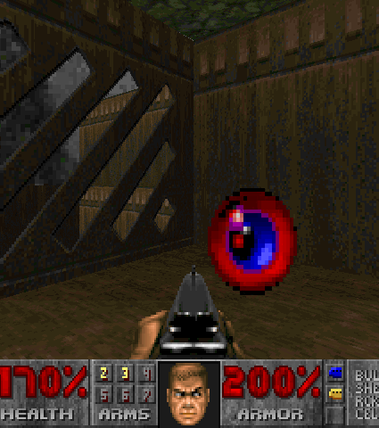

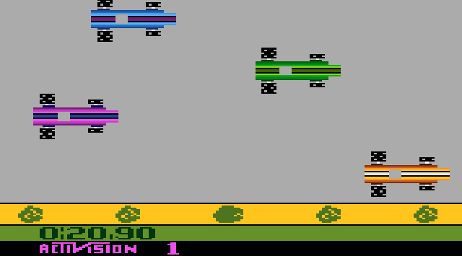
Game Features
A moveable top down sprite
Can shoot from the sprite
Powerups and boosts (Added time, better weapons)
Obstacles the player can use for cover
Different arenas to fight in
A time limit
A system to track high scores to show off who has done the best at the game

Slide 7
Possible Enhancements
A co-operative multiplayer mode where two players can create a High score
Different difficulties
Different enemy types (can tie in to different difficulties)
A narrative
Different modes (e.g no time limit or no better weapons)

